Slide 1

Comparison of Model Offshore Wind Speed Performance Using Lidar Buoy Data off the U.S. Atlantic and Pacific Coasts
25 January • AMS 2022
Lindsay Sheridan Raghu Krishnamurthy Alicia Mahon Will Shaw

Slide 2
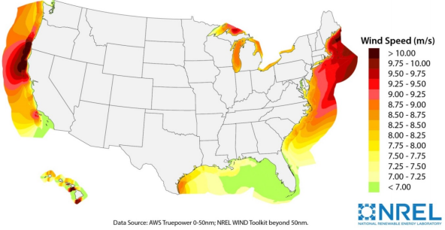
U.S. Department of Energy Lidar Buoy Deployment History
Leosphere Windcube Lidar
Jan 2020 – Jun 2020
3 km off Martha’s Vineyard, MA
Leosphere Windcube Lidar
Oct 2020 – Current
40 km off Humboldt, CA
Vindicator III Lidar
Nov 2015 – Feb 2017
5 km off Atlantic City, NJ
Leosphere Windcube Lidar
Sep 2020 – Oct 2021
50 km off Morro Bay, CA
Vindicator III Lidar
Dec 2014 – May 2016
40 km off Virginia Beach, VA
Musial et al., 2016

Slide 3
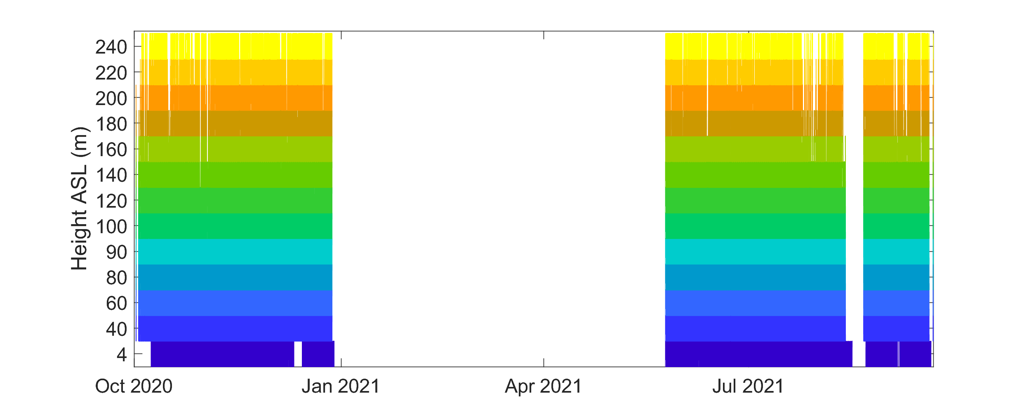
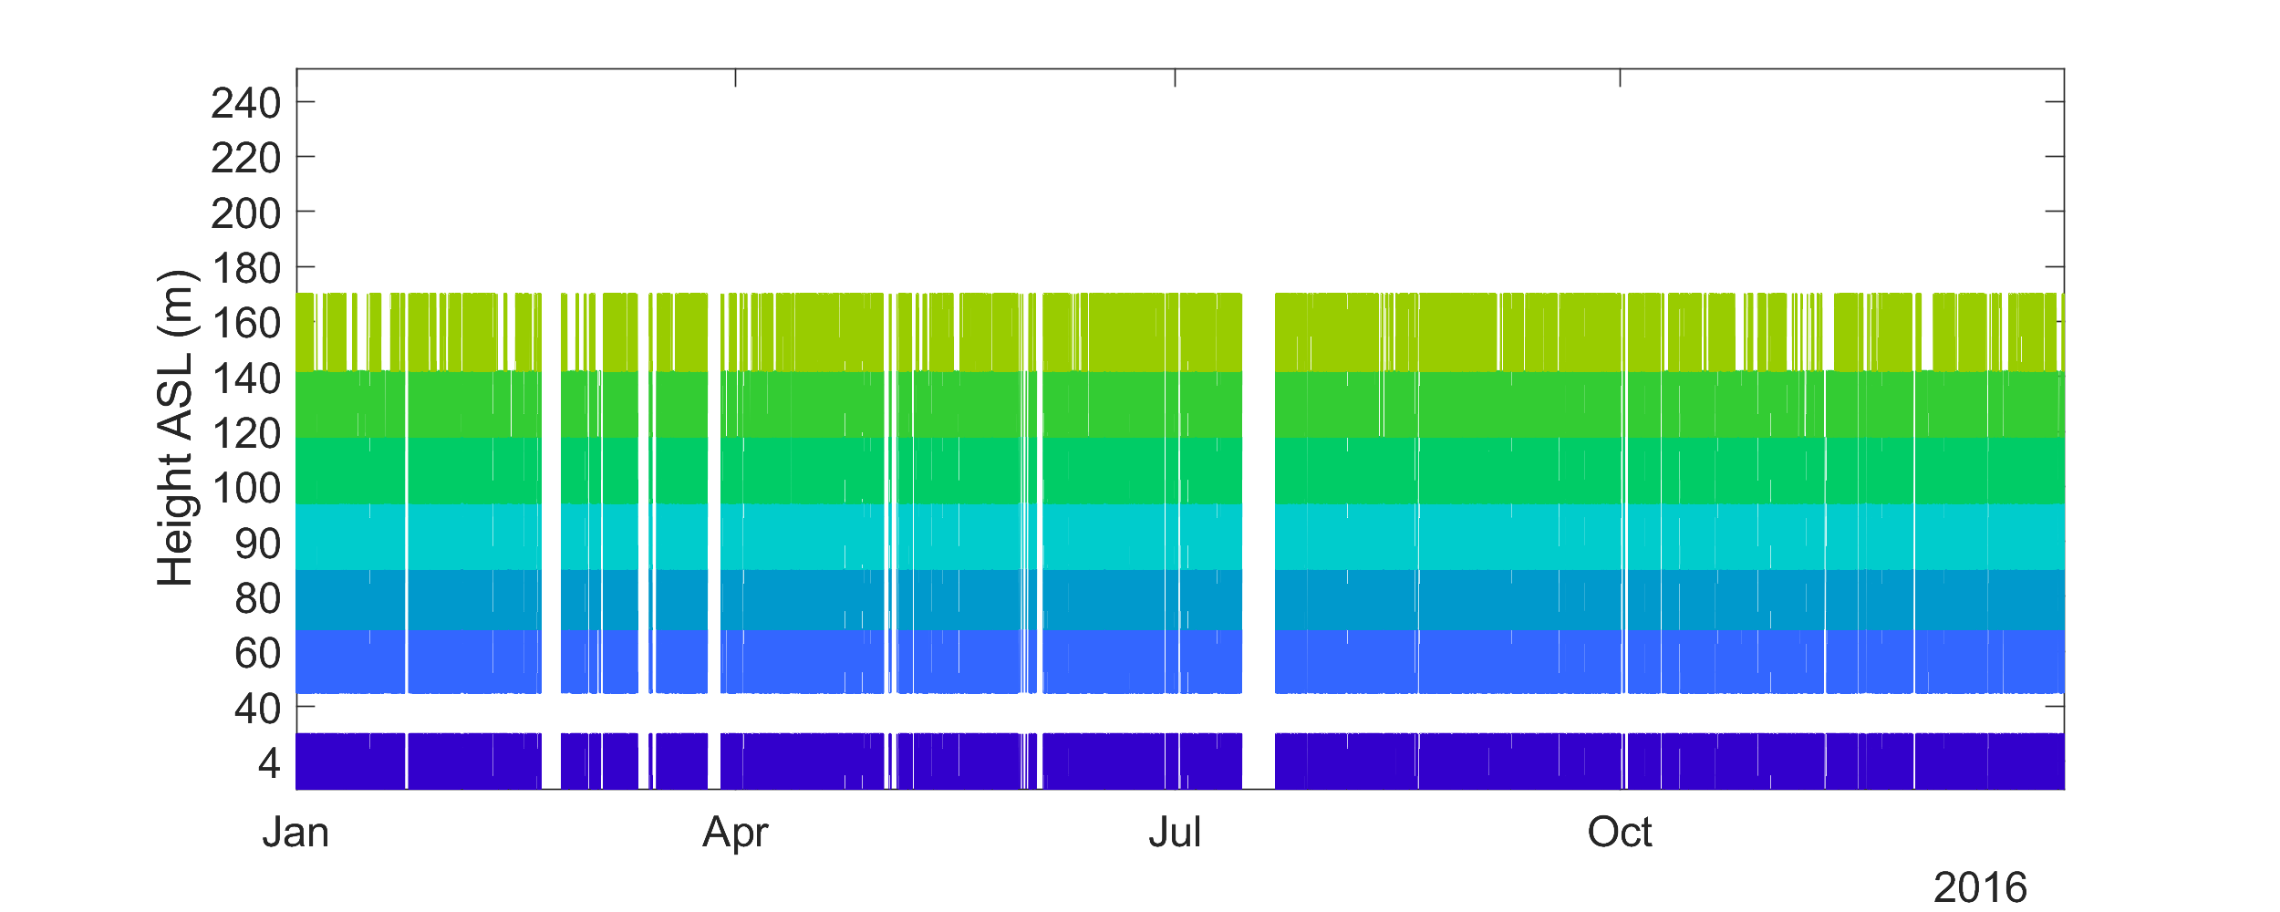
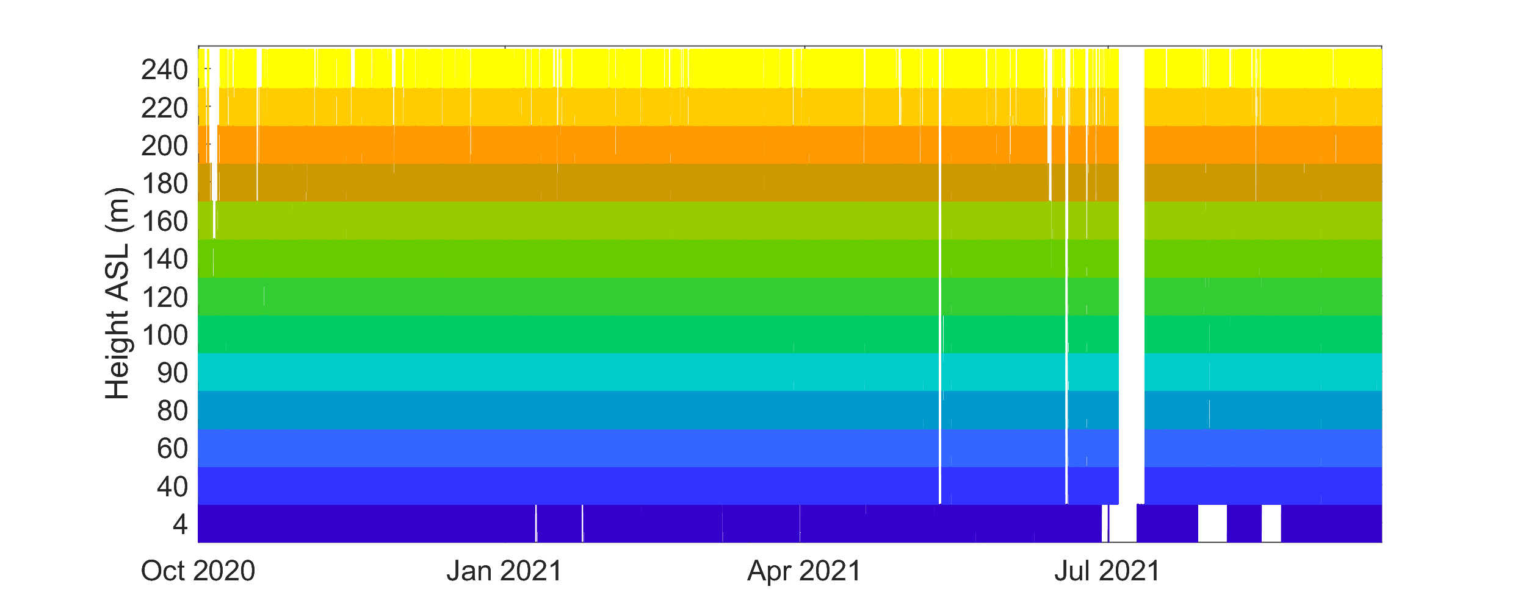
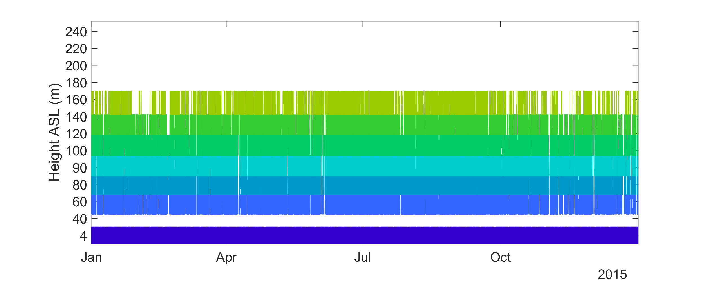
Pacific and Atlantic Observations
Humboldt (Northern CA): 91% at 90 m (excluding wave outage)
New Jersey: 85% at 90 m
Extreme wave induced outage
Morro Bay (Central CA): 96% at 90 m
Virginia: 95% at 90 m

Slide 4
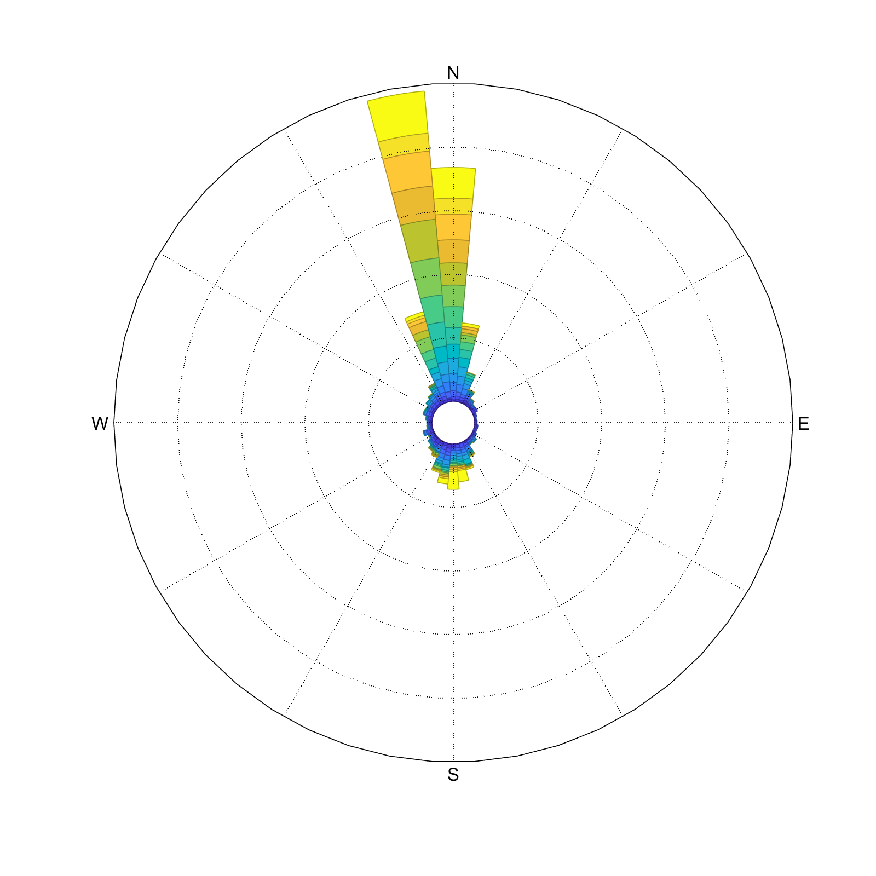
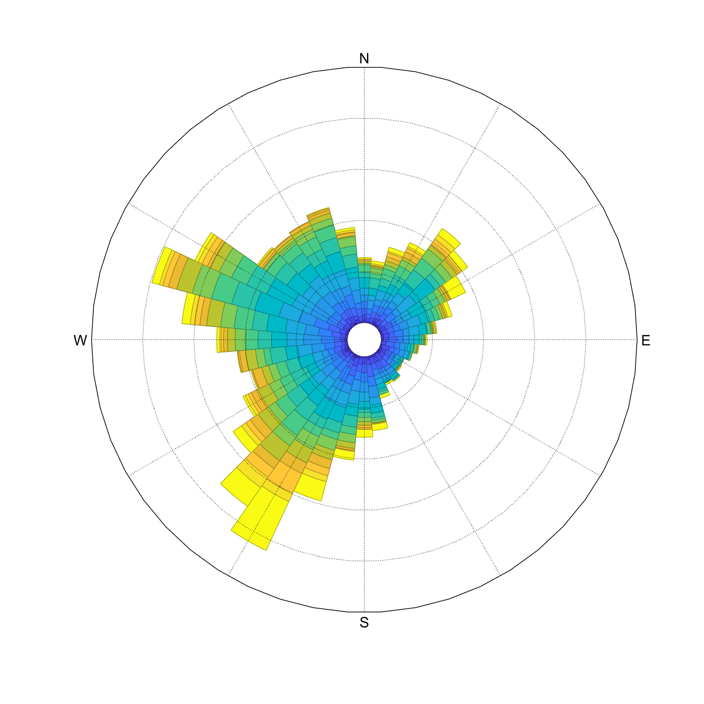
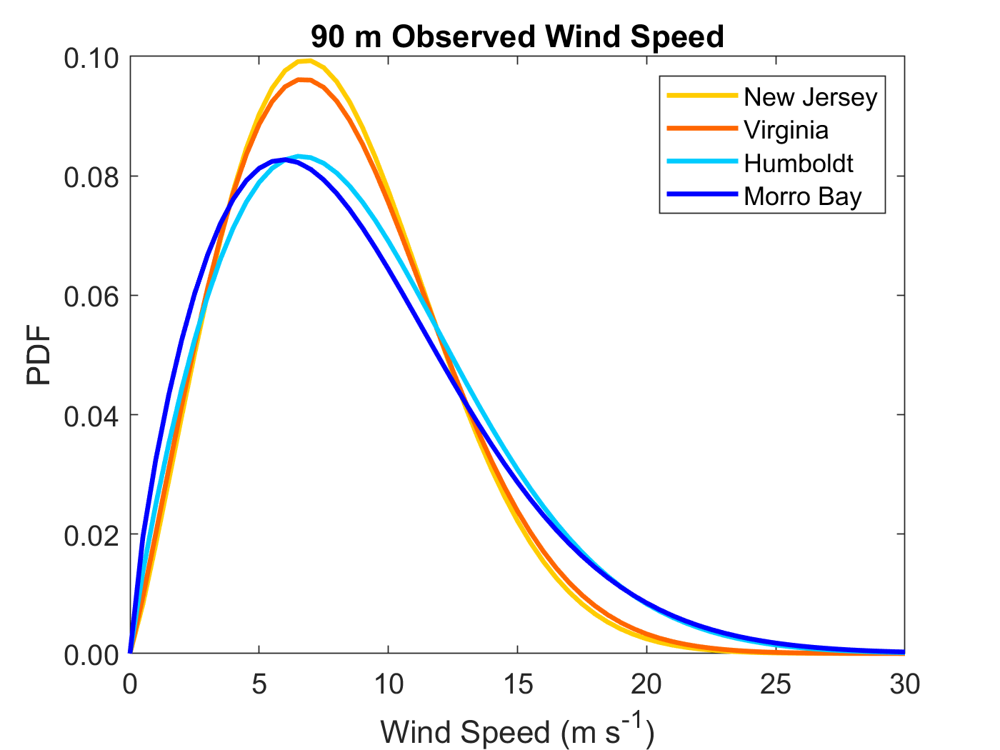
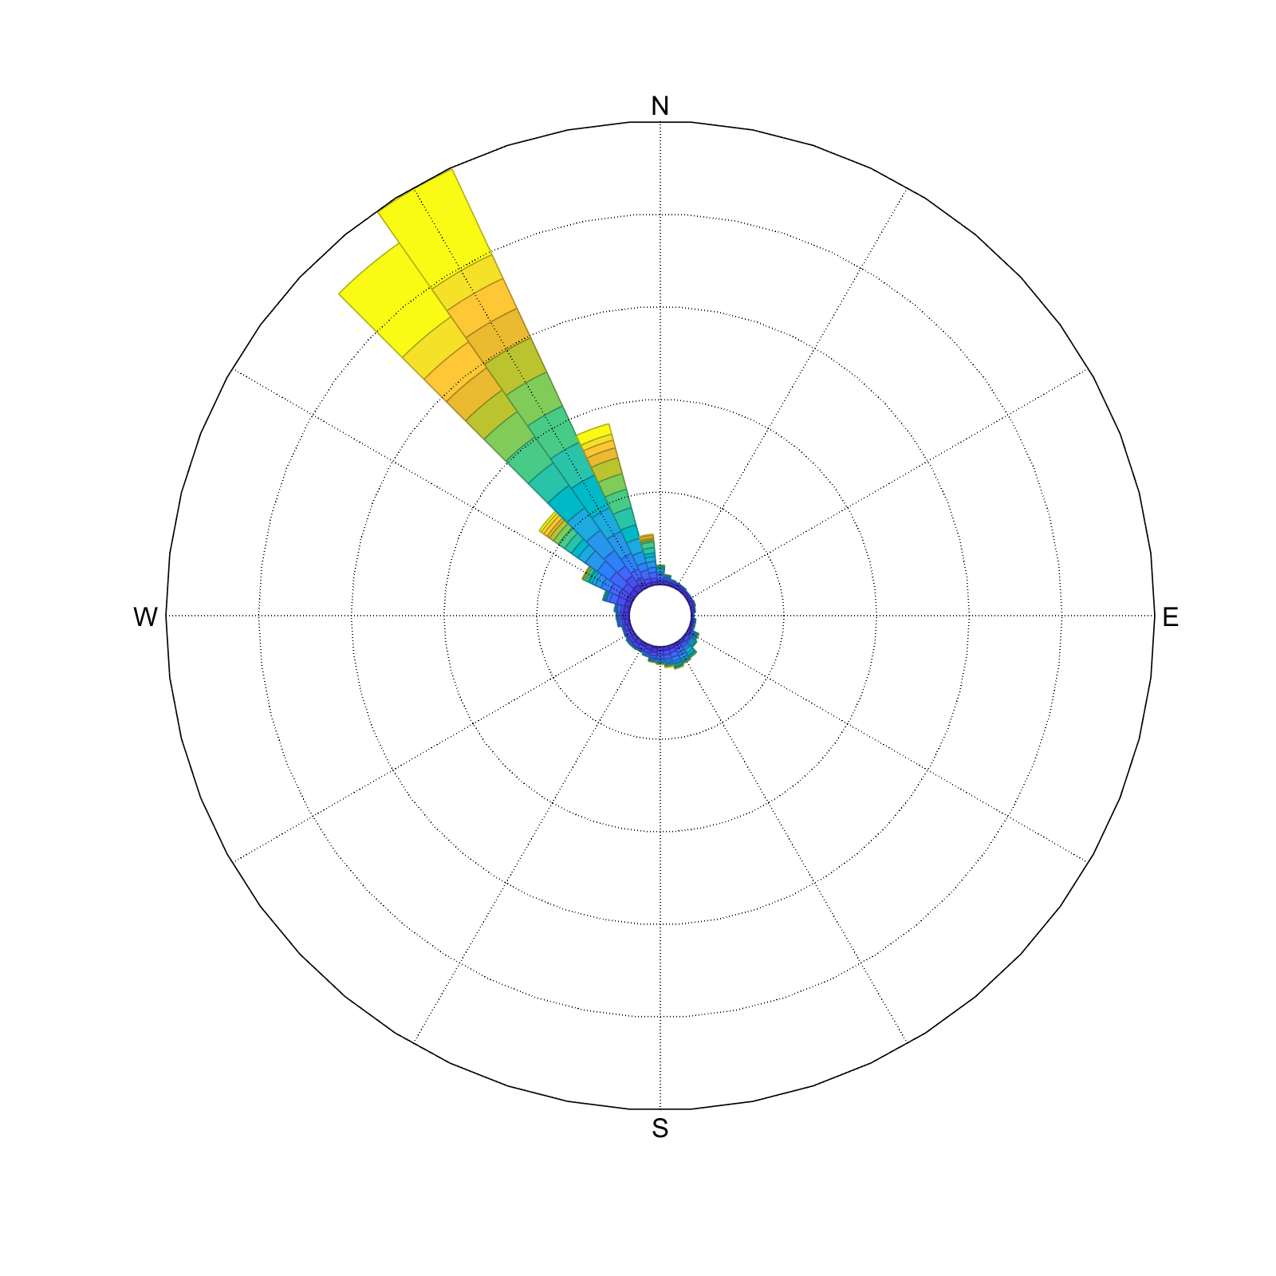
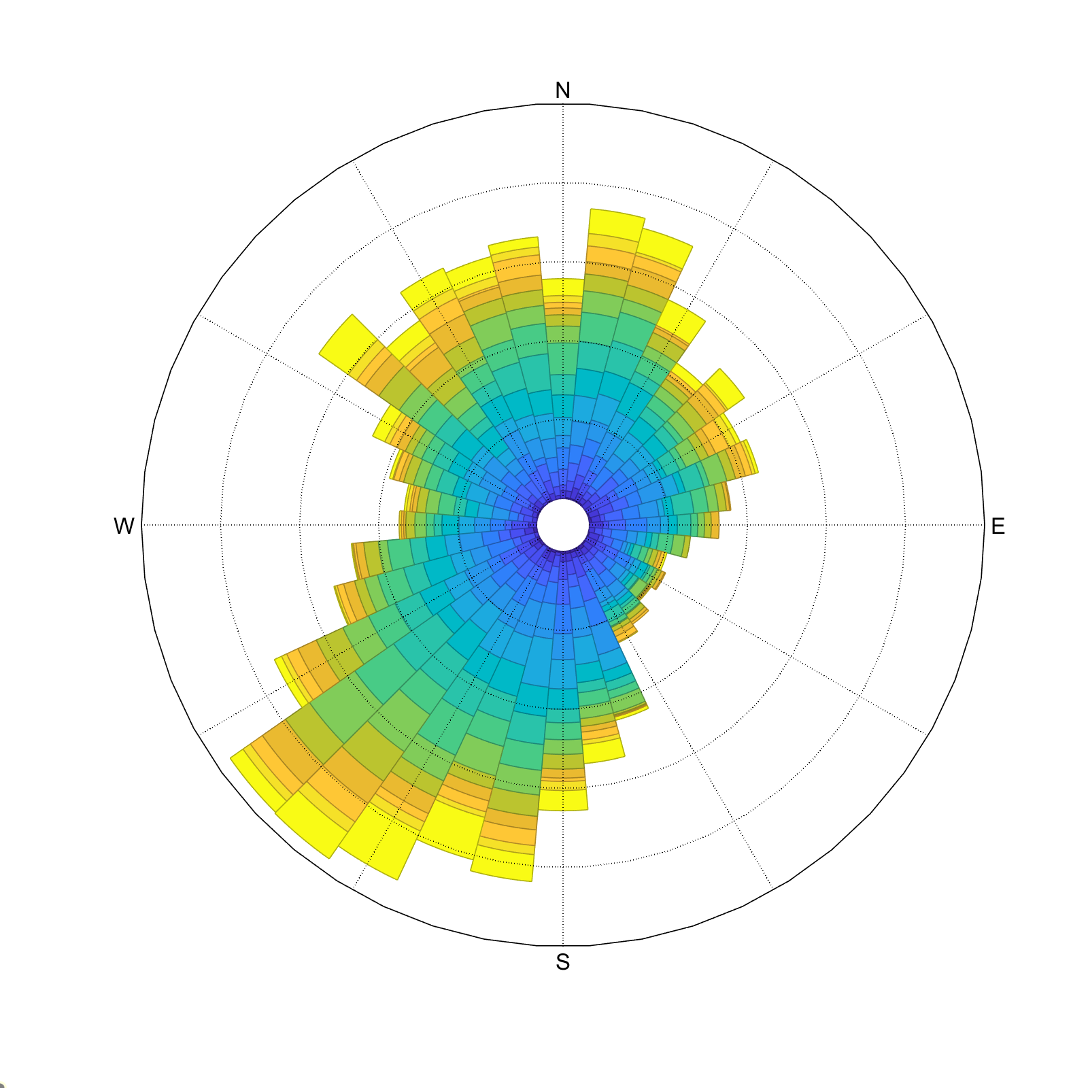


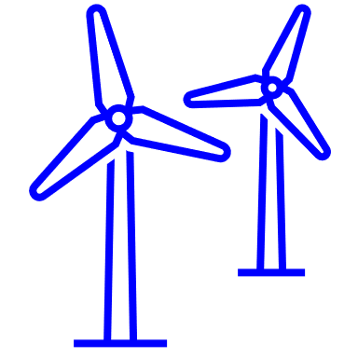

Pacific and Atlantic Observations
Humboldt (Northern CA) 90 m
New Jersey 90 m
Morro Bay (Central CA) 90 m
Virginia 90 m
54%
46%
51%
48%
Gross capacity factors simulated using the NREL 6 MW reference power curve (Musial et al., 2019)

Slide 5
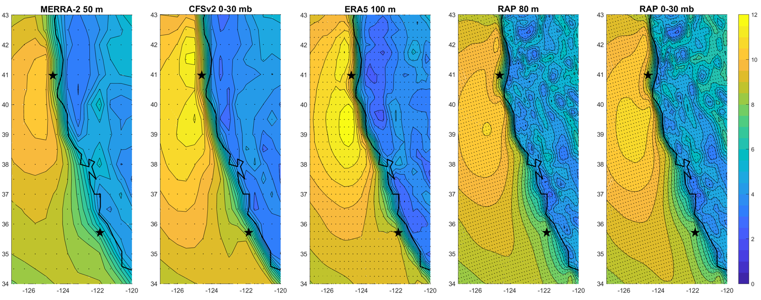
Validation of Model Wind Resource Using Lidar Buoy Data
Product | MERRA-2 | CFSv2 | ERA5 | Rapid Refresh
Developer | NASA | NOAA | ECMWF | NOAA
Temporal Coverage | 1980 - present | 2011 - present | 1950 - present | 2012 - present
Temporal Output Frequency | 1-hr | 1-hr | 1-hr | 1-hr
Spatial Coverage | Global | Global | Global | North America
Horizontal Grid Spacing | 0.5° x 0.625° | 0.5° | 0.25° | 13 km
East Coast Wind Speed Output Heights/Layers → Observation Height | Power Law (α 10 m, 50 m) → 90 m | Lowest 0-30 mb ASL → 90 m | Power Law (α 10 m, 100 m) → 90 m | Lowest 0-30 mb ASL → 90 m
West Coast Wind Speed Output Heights/Layers → Observation Height | 50 m → Linear Interpolation (40 m, 60 m) | Lowest 0-30 mb ASL → 80 m | 100 m → 100 m | 80 m → 80 m
Wind Speed (m/s)

Slide 6
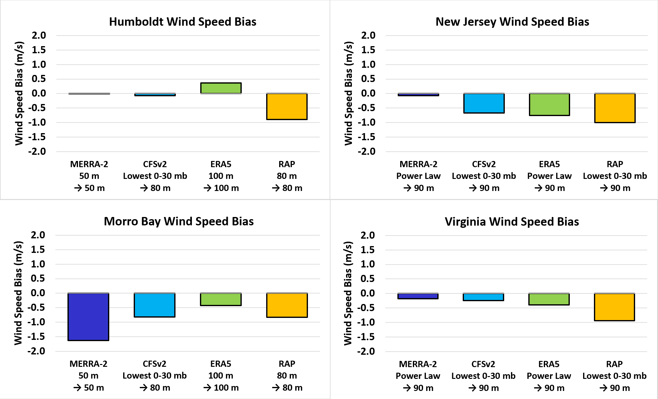
Model Bias During East and West Coast Deployments
+1 pp -1 pp +4 pp -9 pp
+1 pp -6 pp -6 pp -8 pp
-15 pp -6 pp -1 pp -5 pp
-1 pp -3 pp -4 pp -8 pp

Slide 7
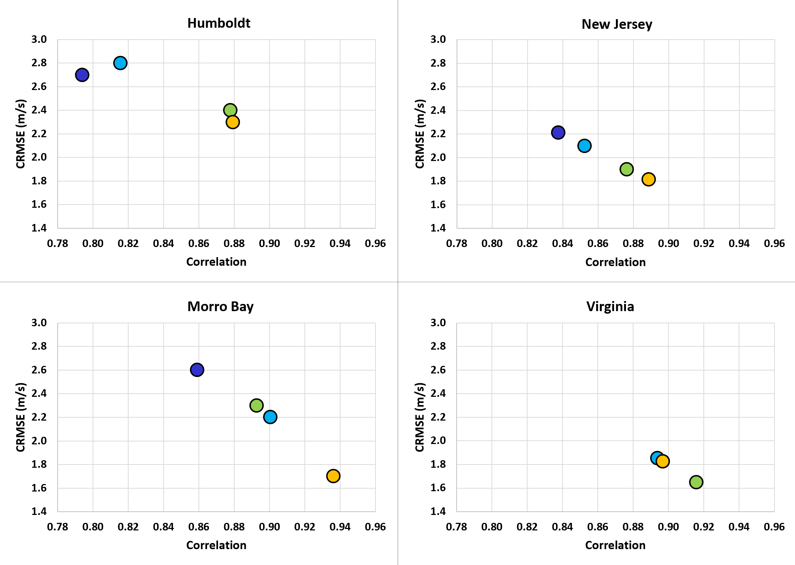
Model Correlation and CRMSE During East and West Coast Deployments
CFSv2
MERRA-2
ERA5
RAP
MERRA-2 performed the same as RAP

Slide 8
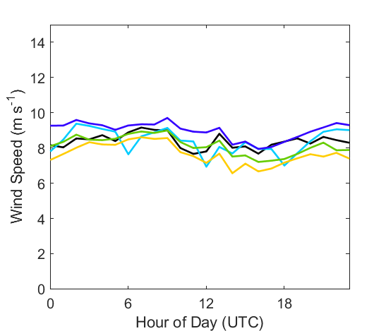
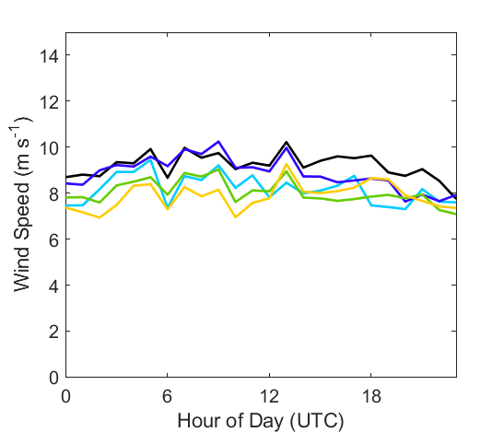
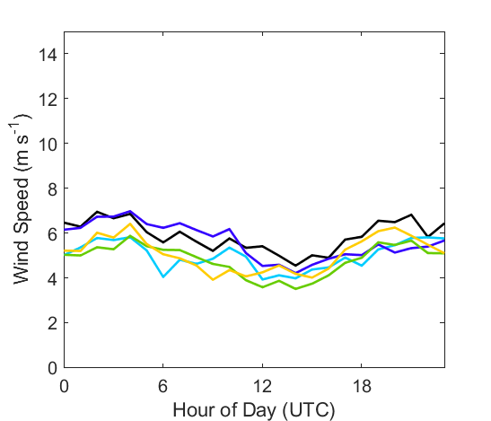
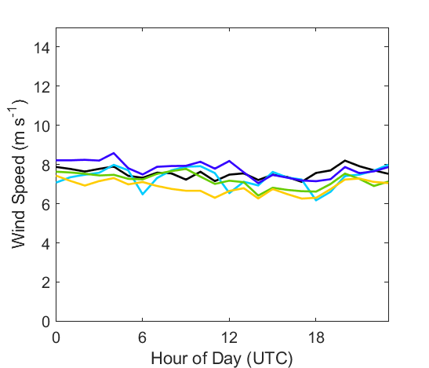
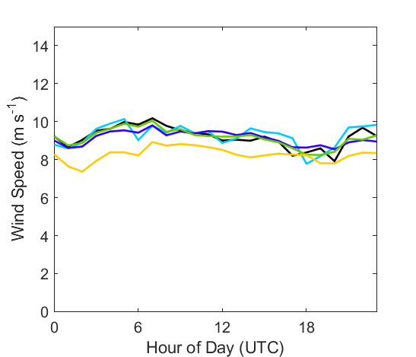
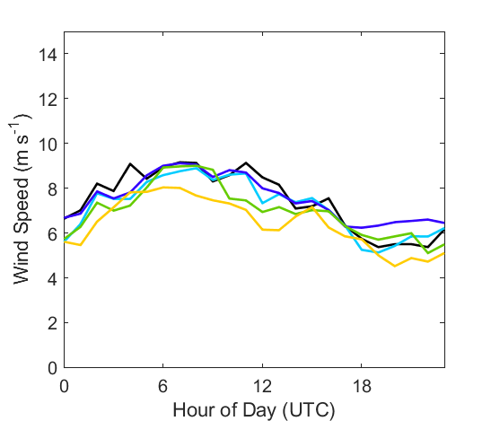
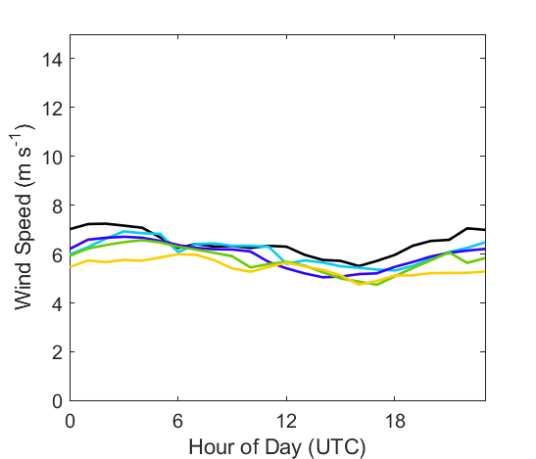
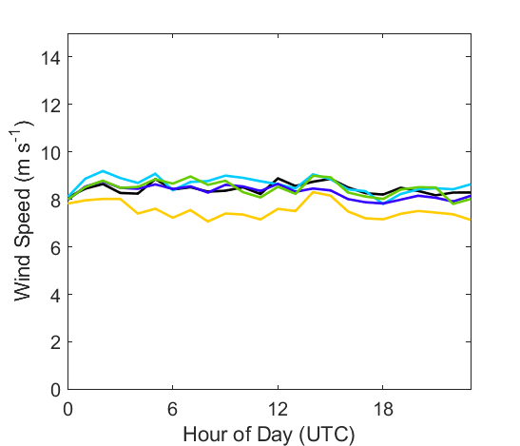
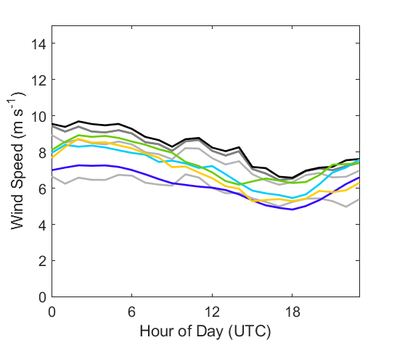
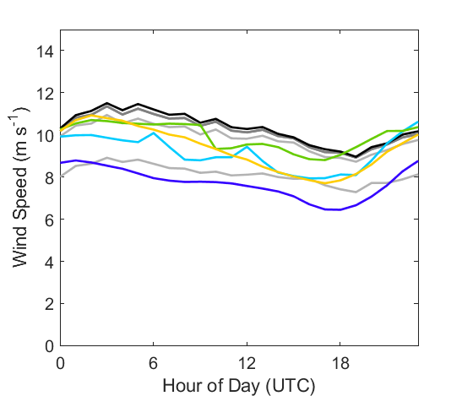
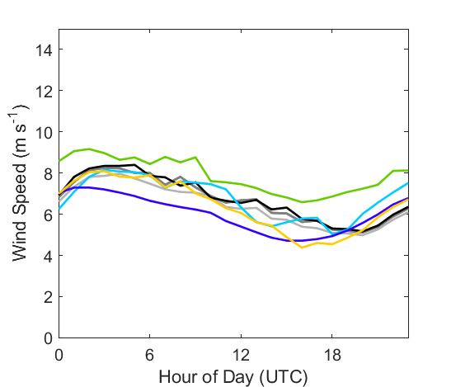
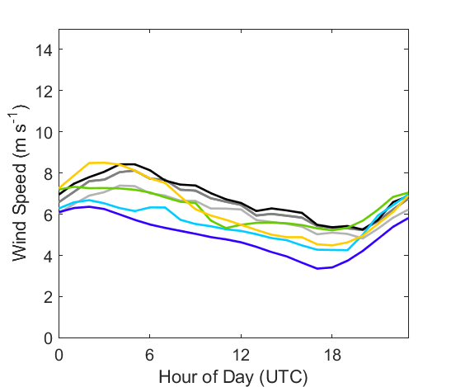
Seasonal and Diurnal Performance: New Jersey, Virginia, and Morro Bay
New Jersey
January 2016
April 2016
July 2016
October 2016
Virginia
New Jersey Most pronounced diurnal trends in the extreme months of the year
Virginia Little diurnal variability except during spring, when faster winds occur at night
Morro Bay Consistent diurnal wind speed pattern through year: fastest in the evening and at night, slowest in the morning
Reanalyses capture observed diurnal trends throughout the year
January 2015
April 2015
July 2015
October 2015
Morro Bay, CA
Observations
MERRA-2
CFSv2
ERA5
RAP
January 2021
April 2021
July 2021
October 2020

Slide 9
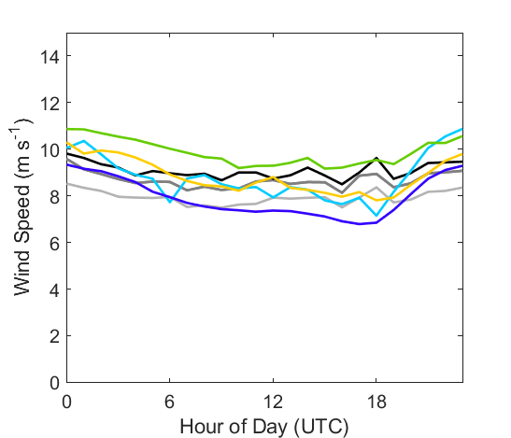
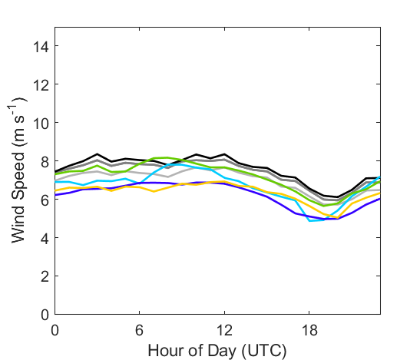
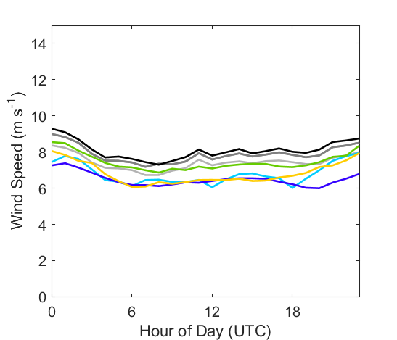
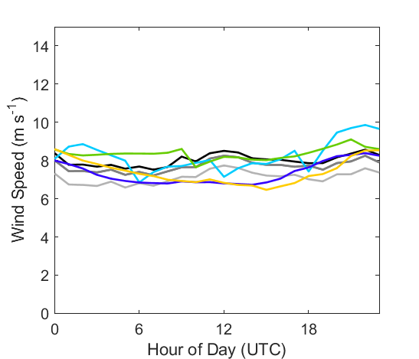
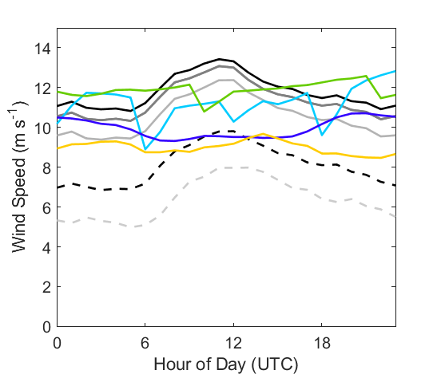
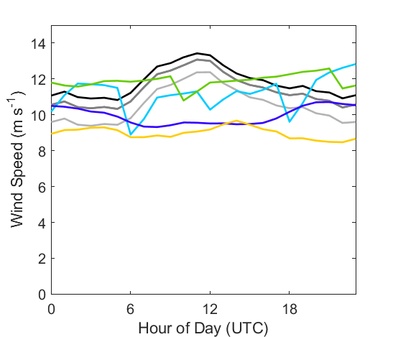
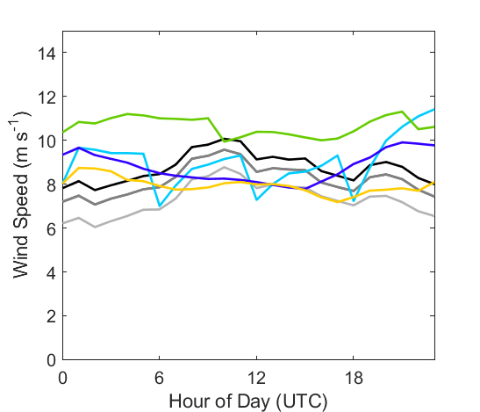
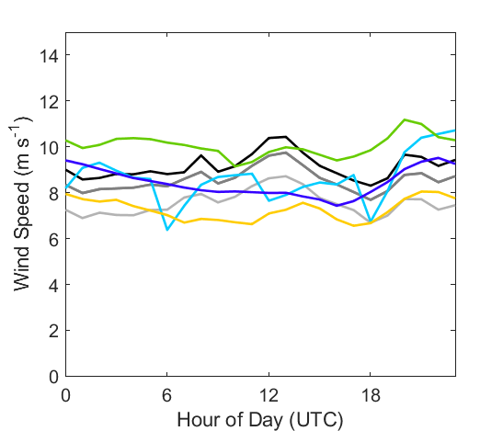
Seasonal and Diurnal Performance: Humboldt
October 2020
November 2020
December 2020
Observations
MERRA-2
CFSv2
ERA5
RAP
Inconsistent diurnal wind speed patterns through year
Reanalyses fail to capture summer diurnal wind speed pattern
June 2021
4 m lidar buoy
4 m nearby NDBC buoy
July 2021
August 2021
September 2021

Slide 10

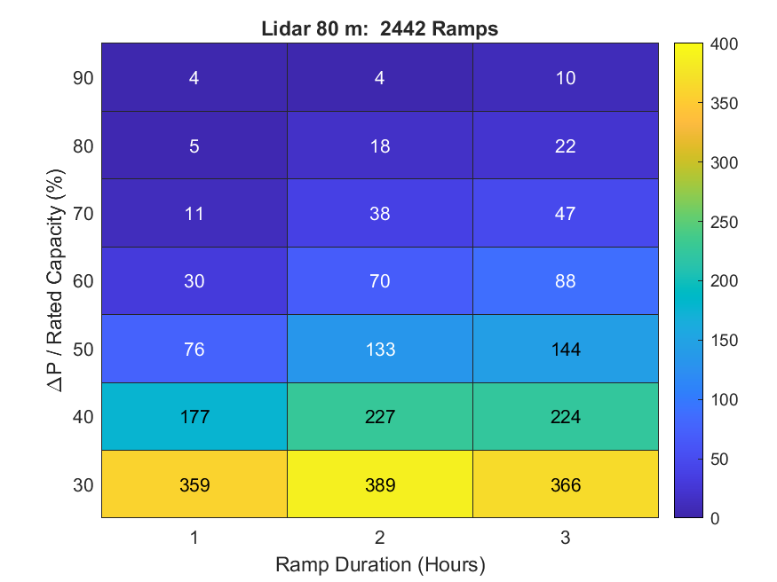
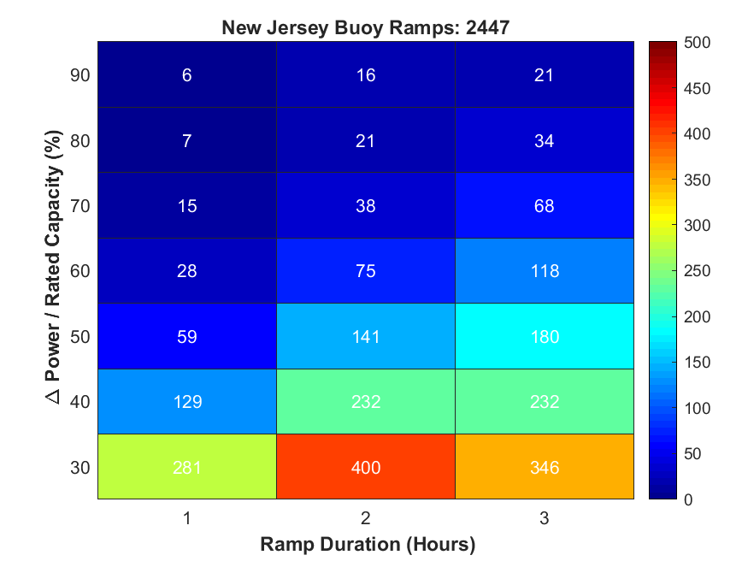
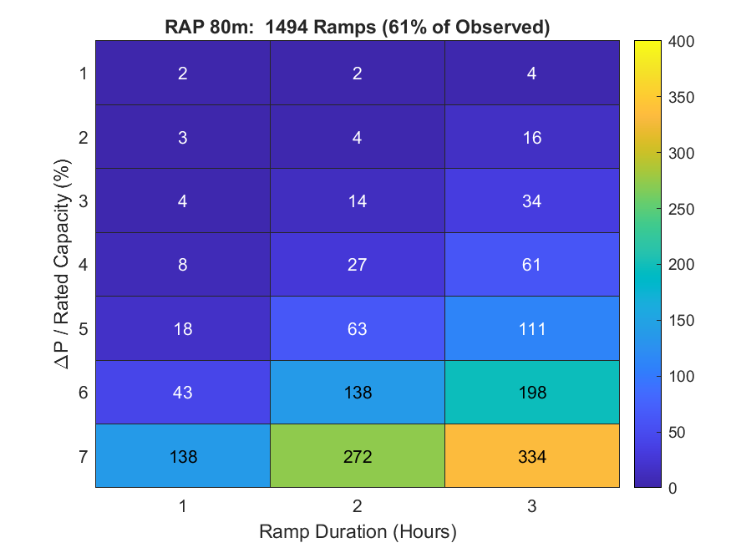
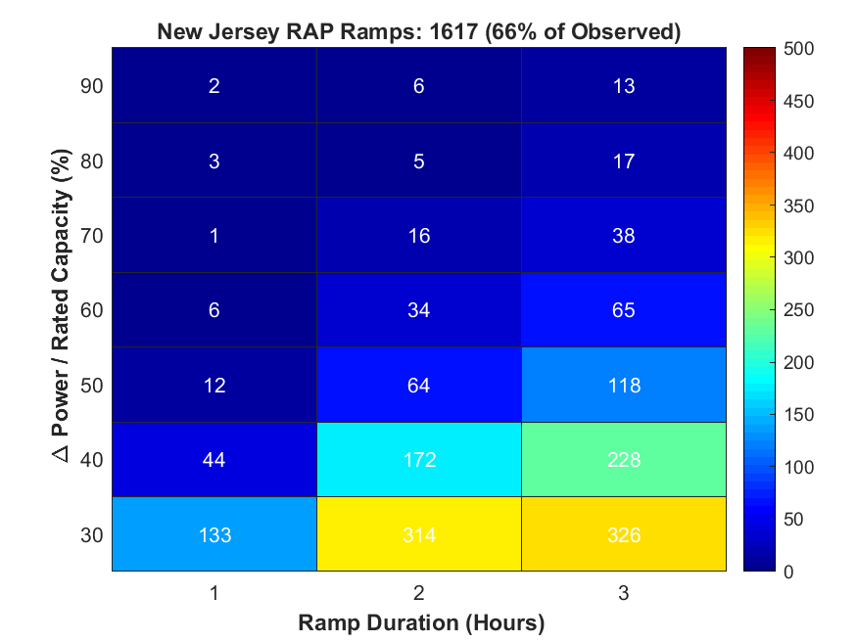
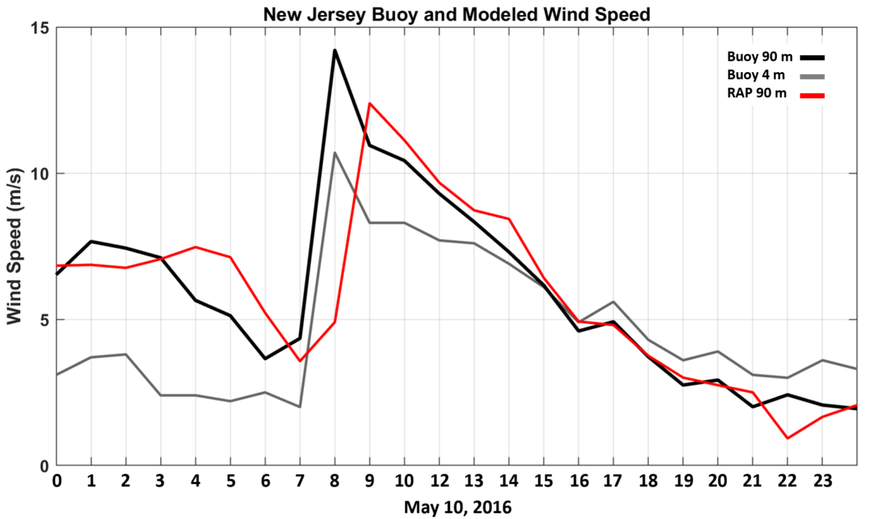
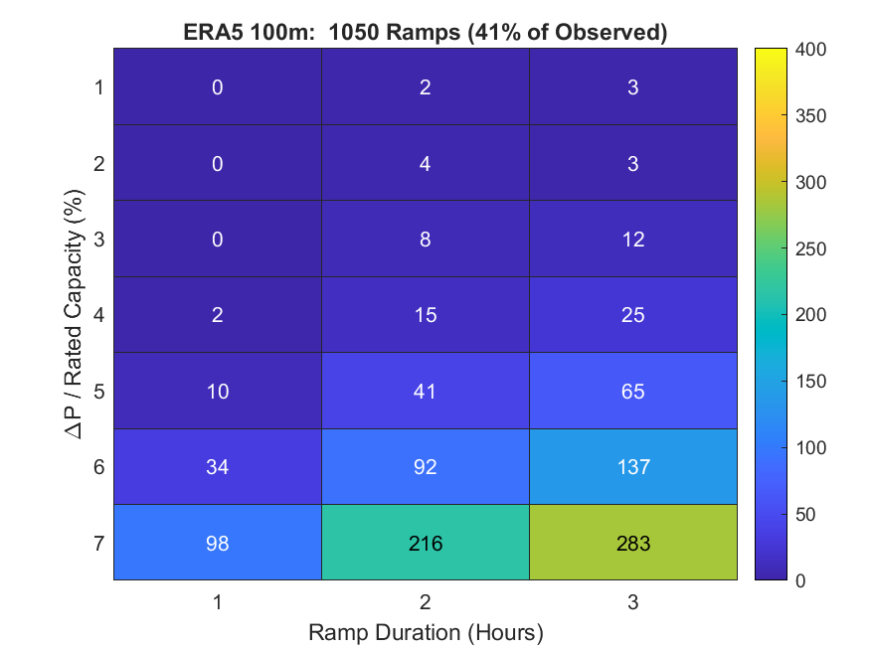
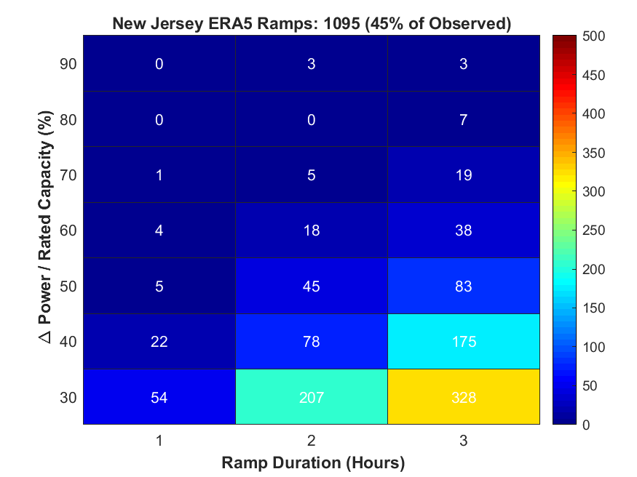
Sources of Error: Ramps and Timing
Morro Bay
Combined Up and Down Ramp Frequency
Fixed interval method ΔP = P_{T+1} – P_{T} (Bianco et al., 2016)

Slide 11
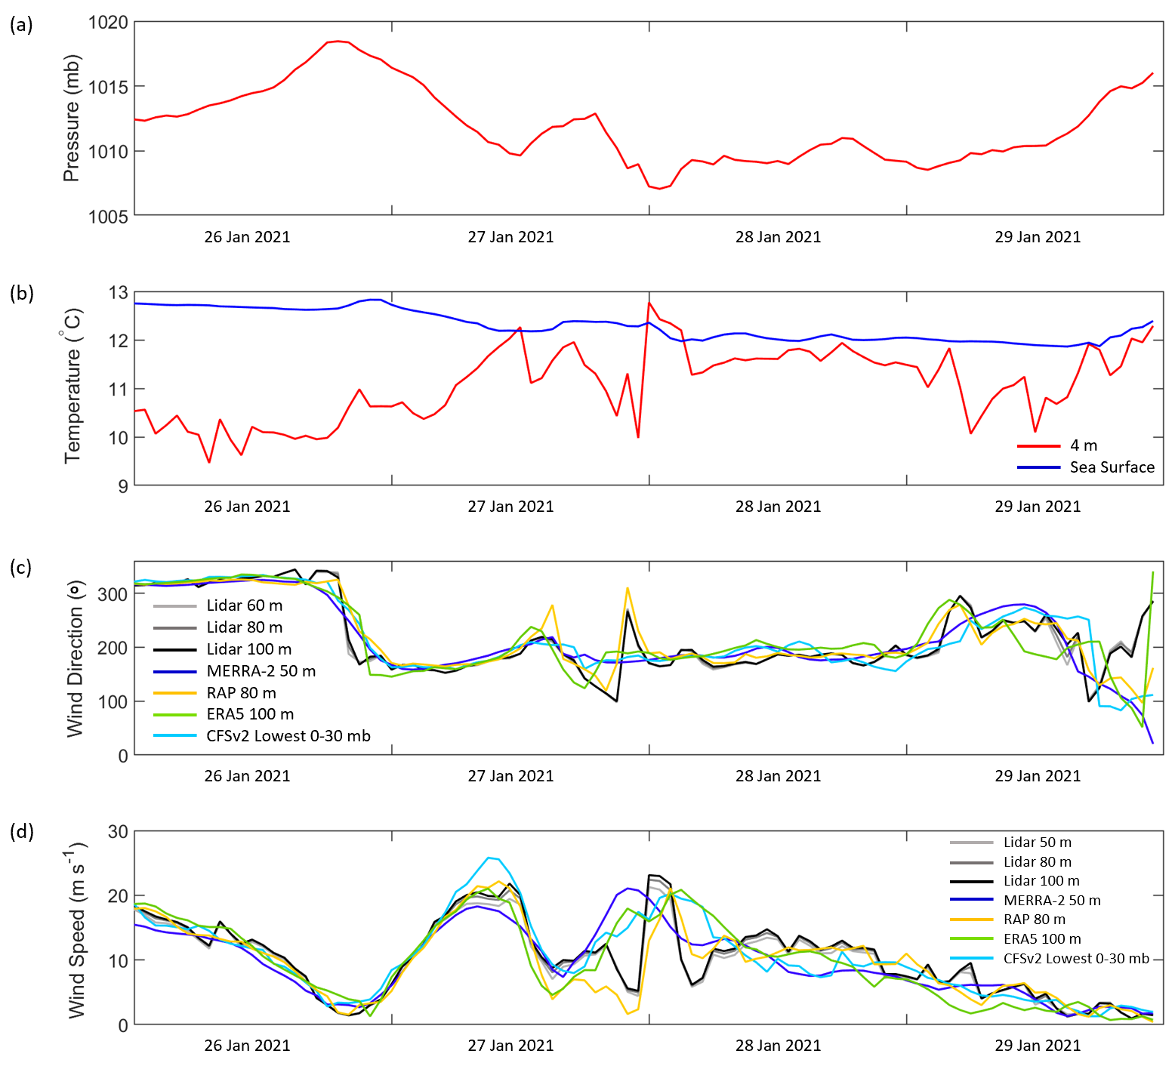
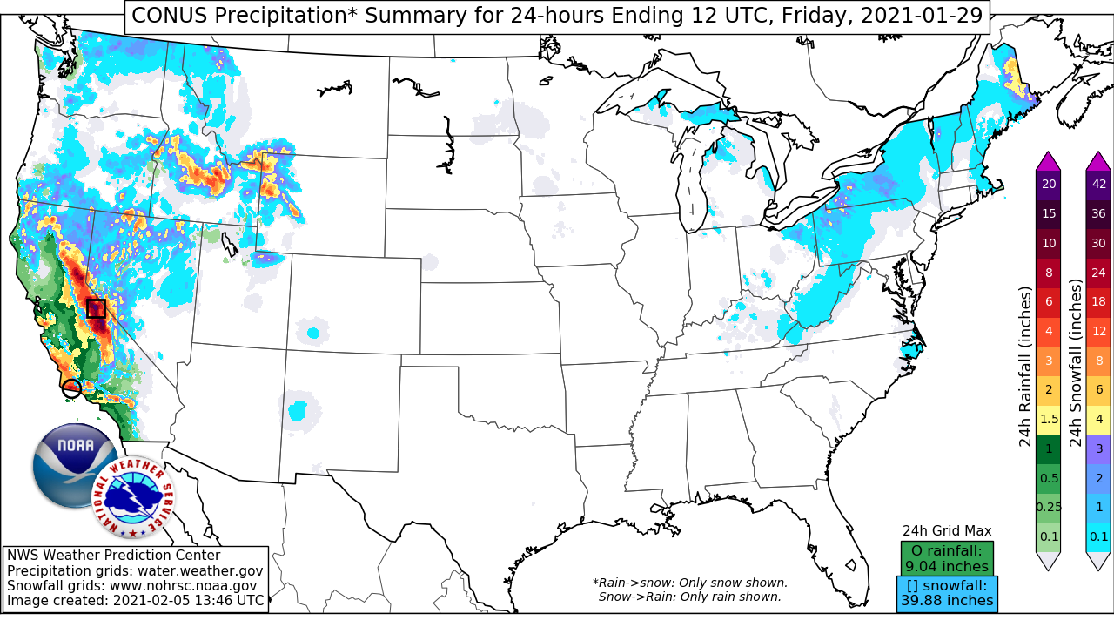
January 2021 Western U.S. Atmospheric River
Morro Bay
Only RAP captures the shift from easterly to westerly winds and the ramp event

Slide 12

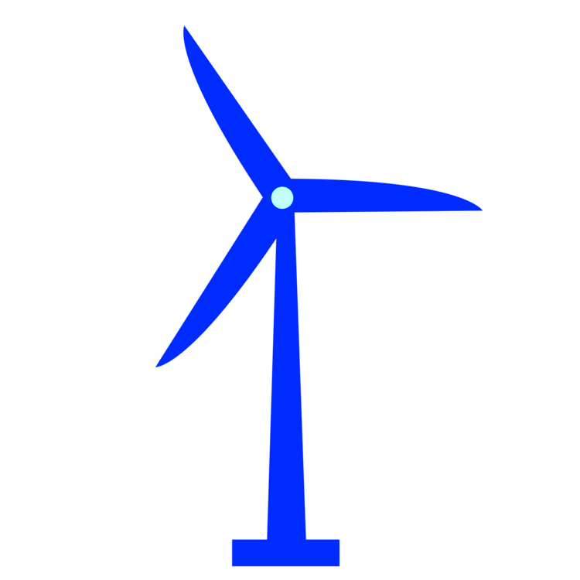
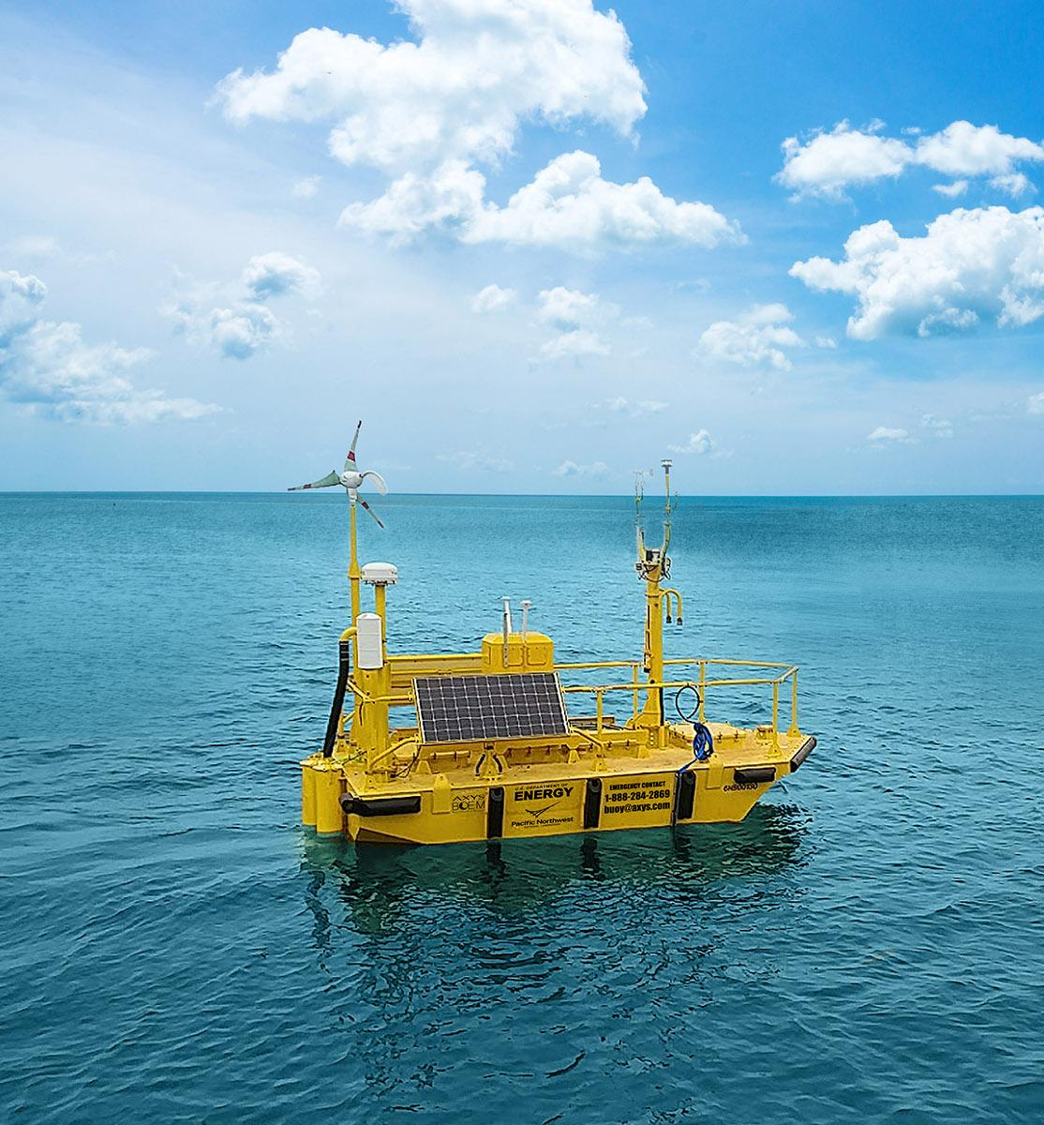
Summary
Rapid Refresh and ERA5 best represented the rotor-level wind speeds during the Atlantic and Pacific lidar buoy deployments, though Rapid Refresh exhibited a substantial slow bias
Diurnal wind speed patterns well-captured at New Jersey, Virginia, and Morro Bay, but significantly divergent during the summer at Humboldt
Ramp events and wind reversals are challenges for reanalyses
Model biases can result in capacity factors up to 15 percentage points lower than observed wind speeds indicate
12

Slide 13

Upcoming Analysis
Comparisons of lidar profiles and ERA5 profiles during low-level jet events
Continuous Offshore Lidar Large Eddy Simulation Observatory
DOE buoy deployment in Hawaii in partnership with the Bureau of Ocean Energy Management
Coupled wind-wave high-resolution WRF modeling case studies when reanalyses diverge from observations
13

Slide 14
Thank you!
U.S. Department of Energy Wind Energy Technologies Office
Gabriel García Medina
Brian Gaudet
Bill Gustafson
Rob Newsom
Mikhail Pekour
Zhaoqing Yang
DOE lidar buoy data are publicly available at a2e.energy.gov
Lindsay Sheridan • lindsay.sheridan@pnnl.gov

